Slide 1

Pre-Departure Briefing
Summer Programme 2026
Student Development Section | Student Affairs Office University of Macau

Slide 2
Pre-Departure Briefing
01
04
02
05
03
Pre-Departure Checklist - Pre-Departure Preparation - Upon Arrival - After the trip
Group Communication
General Safety Tips
Q & A
How To Handle Culture Shock?

Slide 3
WHAT’S NEXT ?
CHECK YOUR UM EMAIL EVERYDAY!
02
04
Wait for the acceptance letter
Start applying for a travel/ student visa
01
03
05
Start submitting your official application to the Host University
Plan your trip (flight tickets, insurance, local transportation, etc.)
Settle the deposit/tuition fee

Slide 4

01
Pre-Departure Checklist

Slide 5
Pre-Departure Preparation
Passport
Ensure it will remain valid for at least 6 months after your planned travel and make sure you have at least one clear visa page for immigration stamps
Visa
Travel or study visa
For Mainland students, please make sure you extend your Type D – Stay (逗留D) & Stay Permit Application (逗留的特別許可) before departure

Slide 6
Pre-Departure Preparation
Flight
Do not purchase a flight ticket until you receive the acceptance offer from the host university
Make sure you have enough time for transit between flights
Check with your airline for any baggage restrictions
Read the refund policy
Avoid choosing Middle East for connecting flights
Travel Insurance
All participants are required to purchase travel insurance
Purchase from a reputable insurance company and read the policy carefully
Covers travel, hospitalization and out-patient treatment
Covers the whole travel period (not only the programme period)

Slide 7
Middle East Conflict
Stay Informed: Monitor reliable news sources and official government travel advisories regularly. Be cautious with social media posts about your location. Remain aware of your surroundings and travel with peers whenever possible.
Avoid High-Risk Areas: Do not travel to regions currently experiencing active conflict or unrest.
Emergency Contacts: Keep a list of emergency numbers, including your program coordinators, local embassy/consulate, and local emergency services.
Communication: Stay in regular contact with family. Share your itinerary and update them if plans change.

Slide 8
Pre-Departure Preparation
Vaccinations and medicines
Fulfill the requirement of the country/region/the host university
Seek professional advice from your doctor before your trip
Prepare a sufficient amount of face masks, Rapid Antigen Test Kits and medicines (e.g. 退消藥、感冒藥、止痛藥、 腸胃藥, etc.)
Documents
Keep a copy of your passport/ID, insurance, flight ticket in case you lose your phone during your trip
Share these information with your family members. If your travel plans change, remember to update your family and friends
Expenses
Prepare enough local currency for food, local transportation, souvenirs, etc.
Prepare valid credit/ debit card (e.g., VISA, Master, Union pay etc.) that can make overseas transactions
Don't rely on a single form of money. Handle your credit cards and money carefully

Slide 9
Pre-Departure Preparation
Gather Information Of Your Destination
Conduct research on your host university, destination city and country
Currencies, food, local weather, transportation, etc
Laptop, digital camera, charger, plugs and voltage converters, etc
Activate roaming service through your Macao telecommunication services provider or purchase a telephone card in your destination
Prepare formal dressing (if required by your programme)
Accommodation
On and off-campus accommodation recommended by host university
Homestay
Hotel /Air B&B
Book extra accommodation if you plan to travel before or after your official programme dates
Important Contact Information
If you travel to a remote location or to a destination with restricted communication infrastructures, please inform your family and friends in advance.
Prepare an emergency contact list and know the risks of your destination before you go; know the location of the nearby embassy or consulate and be aware of the latest travel warnings issued by the government Reference Information 中國領事服務網: http://cs.mfa.gov.cn/ Macau Government Tourism Office - Tourism Crisis Management 澳門旅遊局 - 旅遊危機處理 Useful information: https://www.dst.gov.mo/zh-hant/others/footer/sitemap.html?code=tourism-crisis-management-faqs Hotline +853 2833 3000 / Email: tc@macaotourism.gov.mo

Slide 10
Two Weeks Before Departure
Submit the following documents to Student Affairs Office:
Round-trip air ticket/bus/train/ferry information (Departure and arrival date & time, flight number, etc)
Insurance (covers the whole travel period)
Programme Fee Payment Record
Accommodation information
Letter of acceptance by the host university *SAO will provide a link before your departure

Slide 11

Upon Arrival
Report to your family immediately right after your arrival
Familiarize yourself with the campus and the neighborhood of your residence/ homestay /hotel
Attend registration orientation activities organized the host university

Slide 12
After You Complete The Programme
Programme Survey
All summer programme participants are required to fill out an online survey and submit a certificate of completion/transcript from the host university
Programme Report
(For students who receive sponsorship from Smart Point, RCs, U-Teams and SAO Programme ONLY)
Single line spacing
Font size :12
Minimum word requirement
Provide at least 2 photos
In English

Slide 13
Sponsorship From UM
Your sponsorship will only be reimbursed after you submit the following documents:
Receipts for air tickets, tuition and accommodation
Transcript and Certificate (Need to pass all courses in order to receive sponsorship)
*Sponsorship cannot exceed MOP 15,000 or 70% of the sum of Tuition + Air ticket + Accommodation
**SAO reserves the right to change the programme type/amount of sponsorship based on the actual expenses spent during the trip

Slide 14
02
General Safety Tips

Slide 15

General Safety Tips
After arriving at host university:
Keep your door locked all the time
Never allow strangers to enter your room
Report any suspicious behavior to the hall manager/host family immediately
Know the location of emergency exits in the building
Do not wander around alone at night and avoid going to high-crime areas
Stay alert for Terrorist Attack and report suspicious behaviors (Crowded places, events, public transport, and iconic locations are some examples of locations that could be potential targets for terrorists)

Slide 16
During Natural Disaster
Stay calm and escape!
Move away from disaster areas immediately
After an earthquake/ fire/ natural disaster/accident, report safety to your family, home and host university coordinator immediately
Do not hesitate to contact your exchange coordinators in the host university as well as Student Affairs Office for assistance
MGTO (旅遊局) Emergency Hotline: (853) 28 333 000

Slide 17
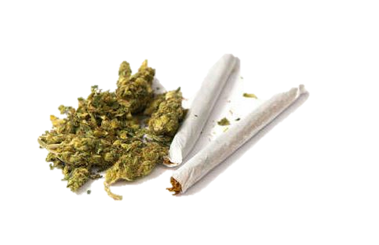





Alcohol and Drugs
Cannabis/ Marijuana
Related products (drinks, skin/scent products, chocolate and candies, etc.)

Slide 18
Telephone/ Internet Fraud
Scam calls/emails/text messages from different government departments/ logistics companies
Money Changing Scam
“Guess Who” Scam
Officials from authorities and government departments will neither issue notice through telephone recording, nor will they request personal data over the phone
If you receive such calls/messages, please reply carefully and conduct verifications through reliable channels
Do not completely rely on caller ID as fraudsters can use software to manipulate phone numbers. Do not log into unverified websites and submit personal and credit card information
When a stranger requests for remittance, money transfer or to provide credit card details or passwords, immediately refuse and hang up
SKYPE ZOOM VOOV MEETING

Slide 19
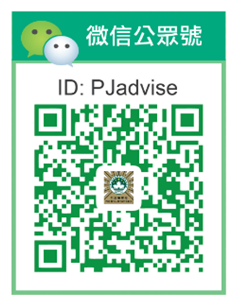
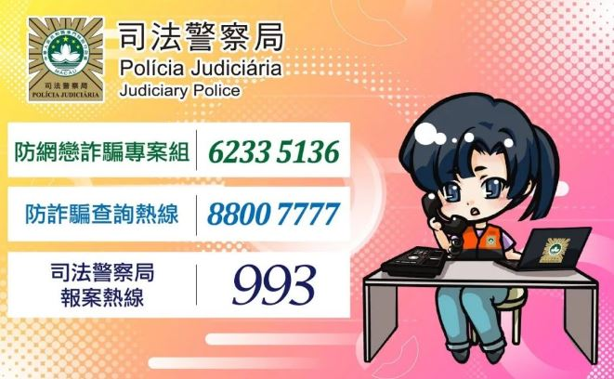
Telephone/ Internet Fraud
24-hour Anti-Fraud Enquiry Hotline: 8800 7777
To report a crime, dial 993

Slide 20
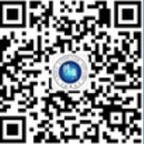
China Consular Affairs (中國領事服務)
For Chinese Citizens
Official Wechat Account : 领事直通车
Provides assistance on the following:
Lost/damaged passports
Accidents/emergencies
Natural disasters
Telephone/internet fraud
How to seek help?
***For students of other nationalities, please check the local embassy information/contact before departure.
Ministry of Foreign Affairs Global Consular Protection and Services 24-hour Emergency hotline: | +86 (10)12308
Download China Consular Affairs APP | Search “中國領事”
Log-in to China Consular Affairs Services “中國領事服務網” website | http://cs.mfa.gov.cn
Office of the Commissioner of the Ministry of Foreign Affairs of the People’s Republic of China in Macao SAR 中華人民共和國外交部駐澳門特別行政區特派員公署 Consular Service Hotline: | +853-66888353

Slide 21

03
Culture Shock

Slide 22

Culture Shock (文化沖擊)
Culture shock is the reaction one faces when confronted with a new cultural environment
Feelings of helplessness
Desire for home and old friends
Physiological stress reactions
Homesickness
Boredom
Rejection of the new culture

Slide 23

How to handle culture shock?
Mental and physical preparation
Research on your host university and country
Stay connected with your friends and family
Try to be familiar with as many customs and cultural trends as possible
Recognize culture shock as part of the travelling adventure
Keep yourself mentally and physically fit
A healthy lifestyle is very important
Try to take time out for yourself
Relax

Slide 24

04
Group Communications

Slide 25

Group Communications
Create chat group
Divide the tasks - Purchase of air tickets - Application of VISA - Insurance - Trip planning

Slide 26
Important Notes
Representing UM
Behave Well
Don’t skip class
Follow the regulations of the host university
Name shown on passport
Do not use your English/nickname
Follow the format on your ID/Passport

Slide 27

Email Etiquette
Greeting and closing sentence
Identify yourself clearly (name, student ID, home University, etc)
Use your UM email
Keep it short and get to the point
Email communications ≠ wechat/whatsapp messages
Your e-mail is a reflection of you

Slide 28
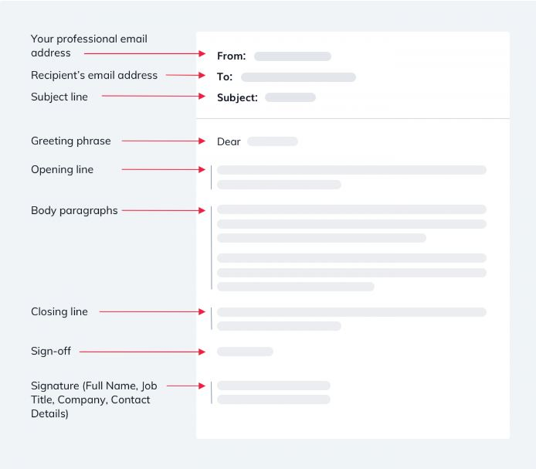

How to write an effective email?
Reference: https://www.tidio.com/blog/how-to-write-a-professional-email/

Slide 29
Questions?
Student Development Section E31-2006 sao.summer@um.edu.mo

